Slide 1



PEILab Group Meeting
Leader: Zicong Hong
Team Member: Jian Lin, Haodong Wang, Qianli Liu, Kaibin Guo, Junjie Liu

Slide 2
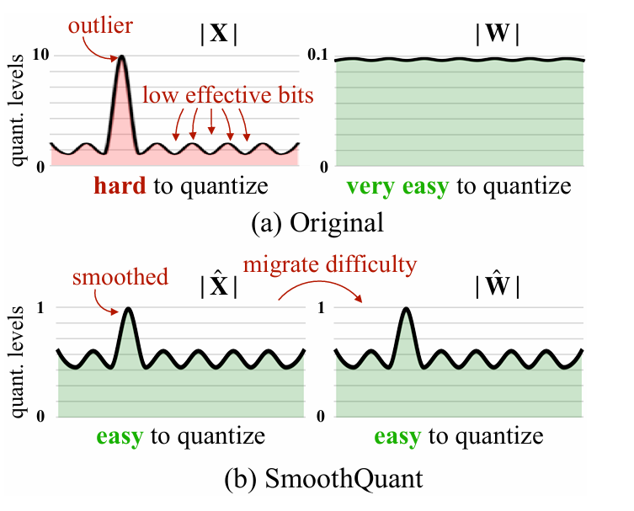
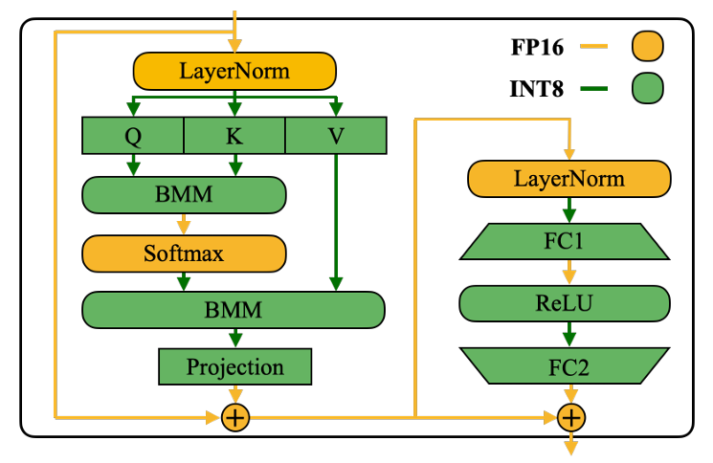
Smoothquant

Slide 3
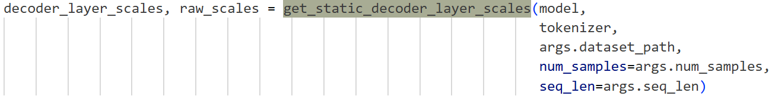
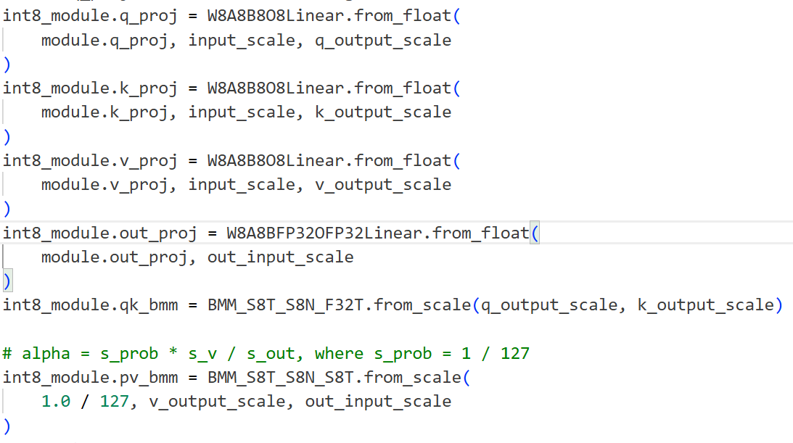
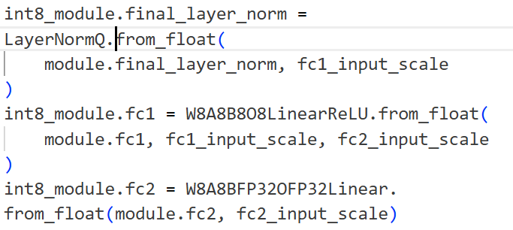
Smoothquant
① 离线统计激活值最大值
decoder_layer_scales: 每一个模块输入或输出激活的最大绝对值除以 127
raw_scales: 每一个模块输入或输出激活的最大绝对值
② 隐式激活值量化

Slide 4
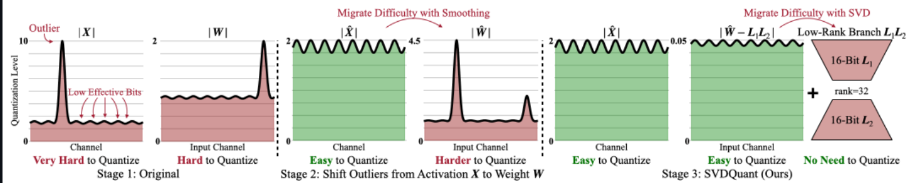
SVDquant

Slide 5
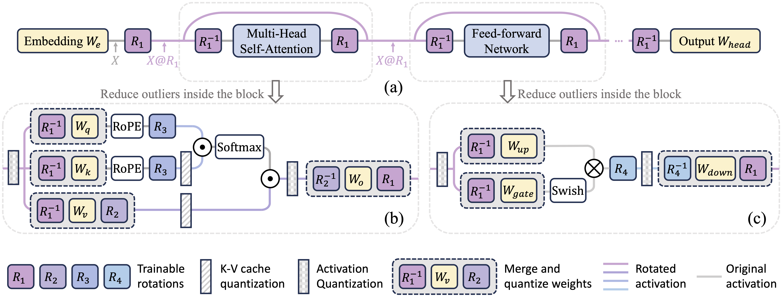
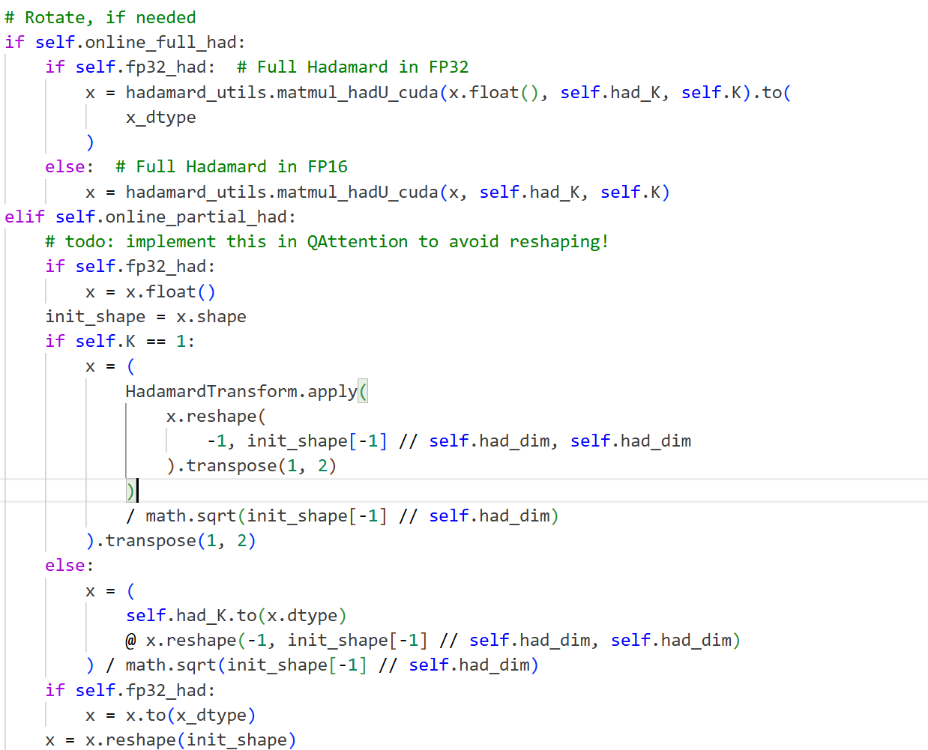
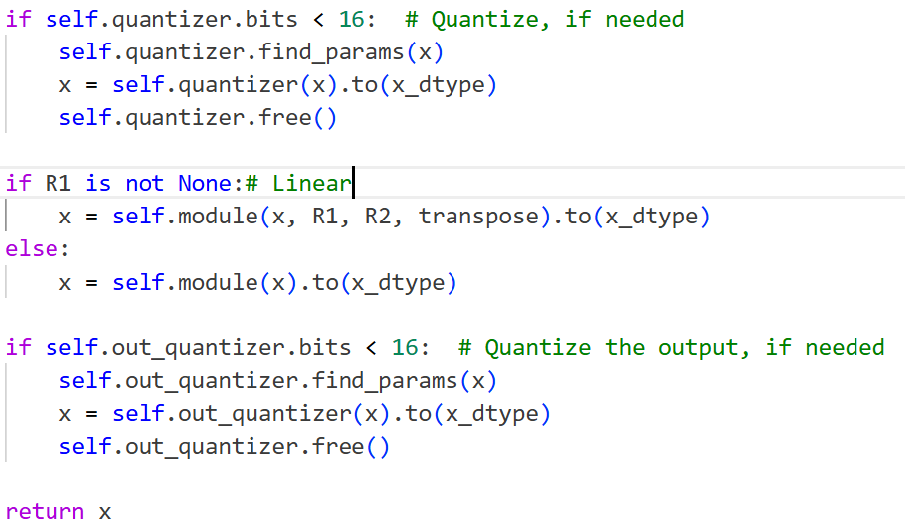
Spinquant

Slide 6
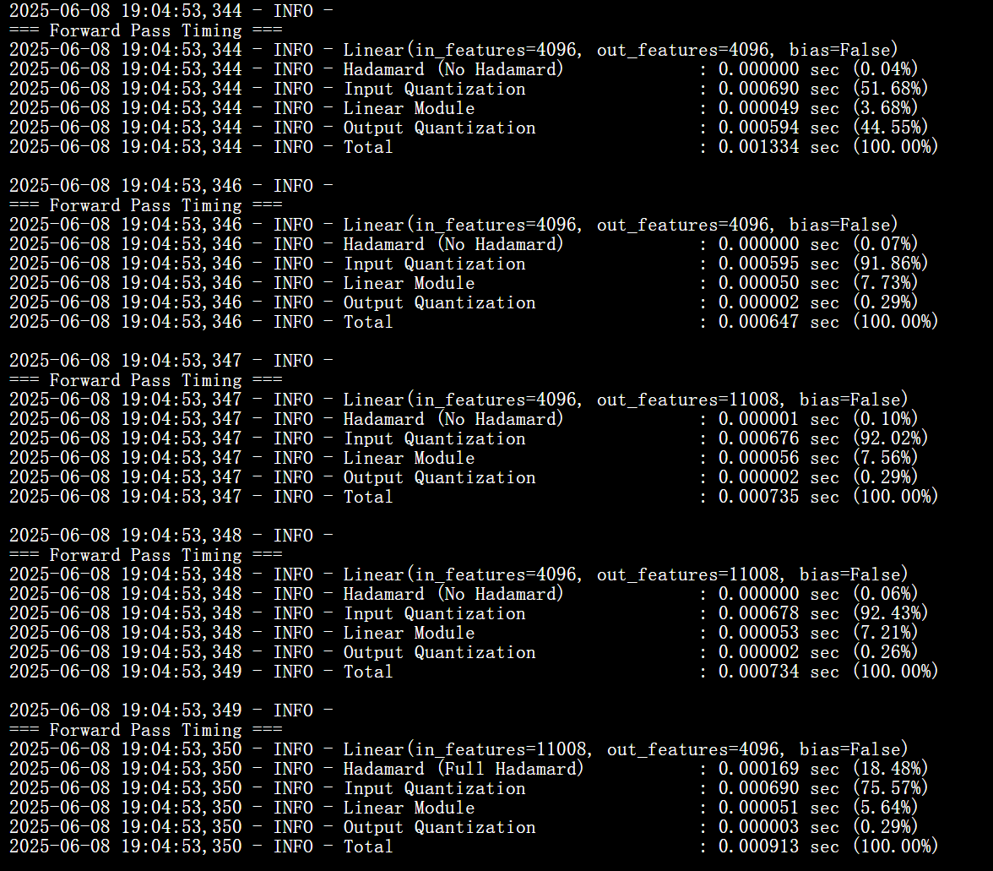
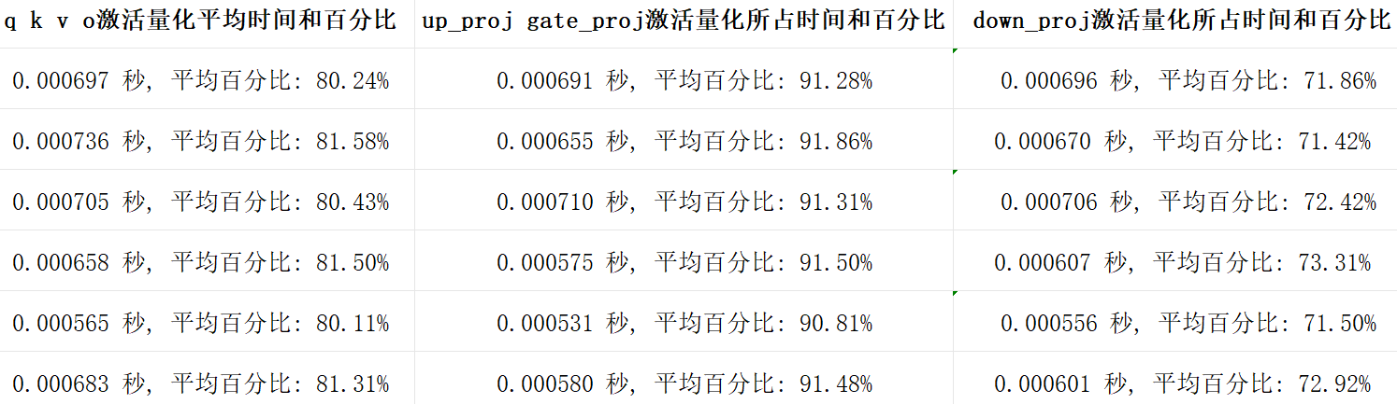
Spinquant

Slide 7
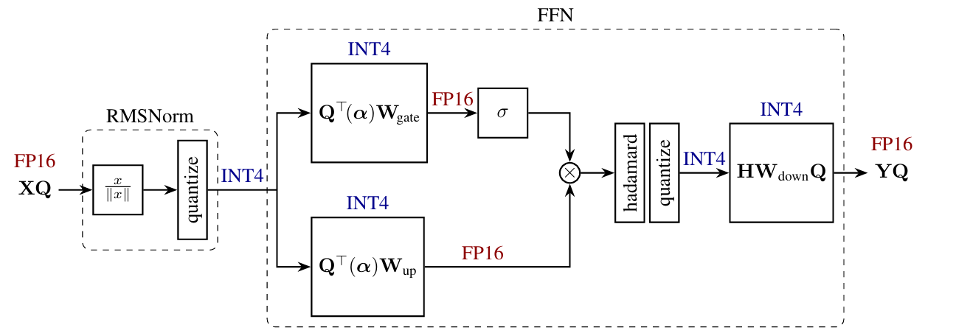
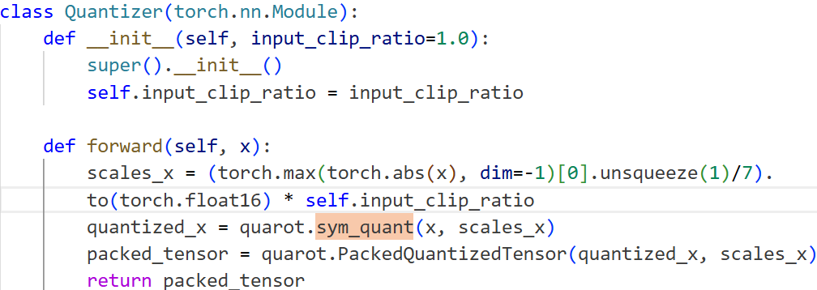
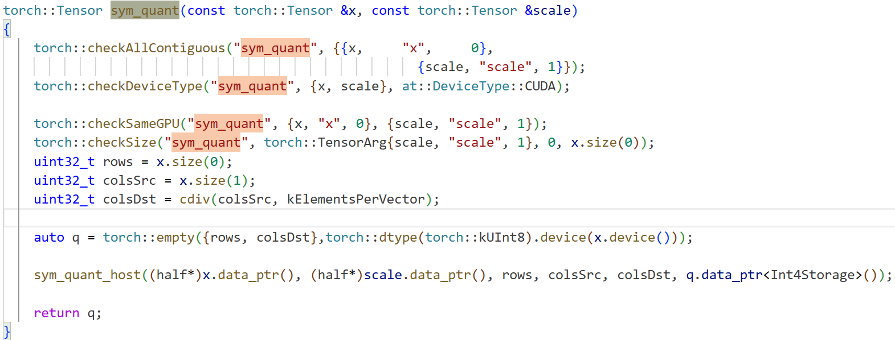
Quarot

Slide 8
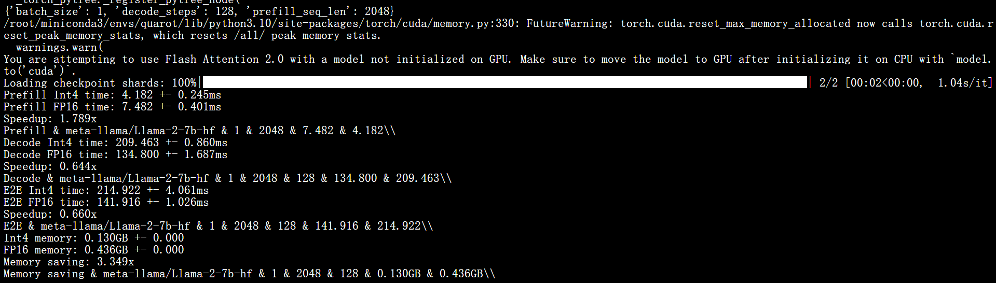
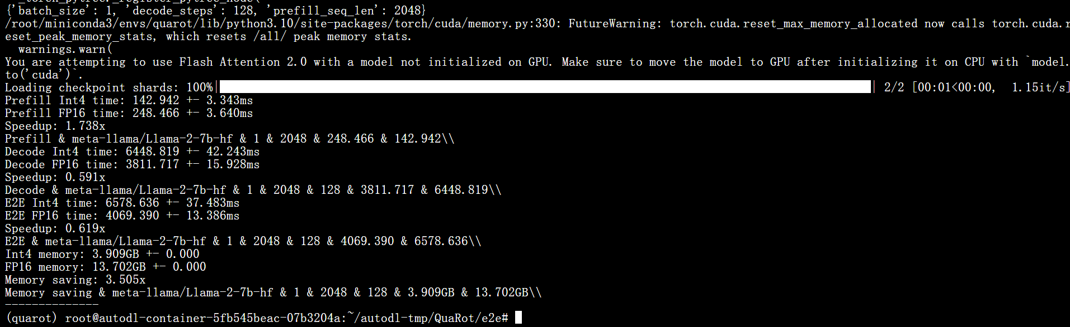
Quarot
meta-llama/Llama-2-7b-hf one layer
meta-llama/Llama-2-7b-hf all layers
batch_size = 1, prefill_seq_len = 2048 ,decode_step = 128
vGPU-48GB

Slide 9
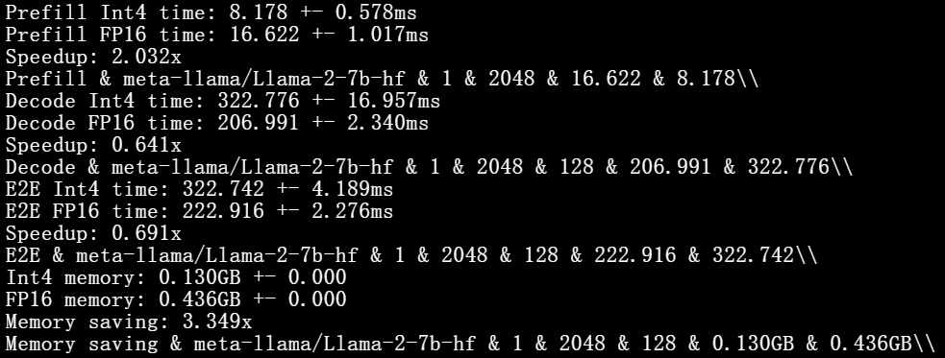
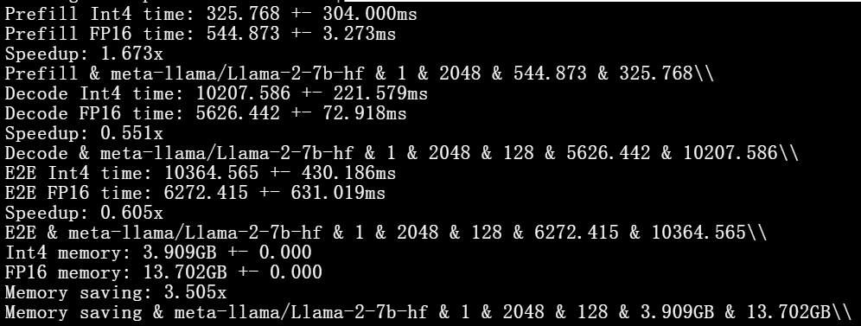
Quarot
meta-llama/Llama-2-7b-hf one layer
meta-llama/Llama-2-7b-hf all layers
batch_size = 1, prefill_seq_len = 2048 ,decode_step = 128
RTX 3090-24GB

Slide 10
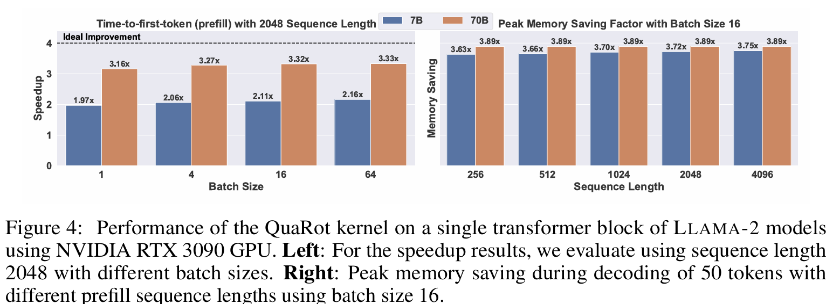
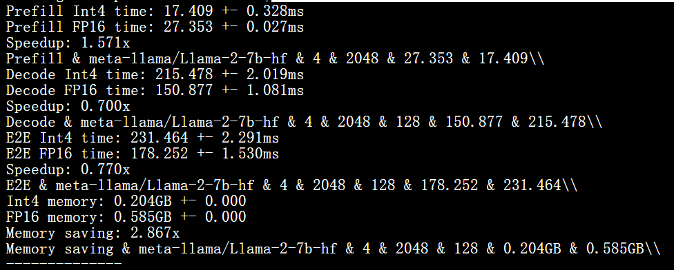
Quarot
batch_size = 1
batch_size = 4
vGPU-48GB

Slide 11
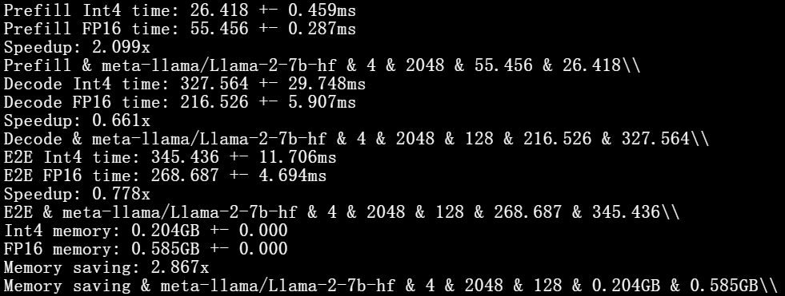
Quarot
batch_size = 1
batch_size = 4
RTX 3090-24GB

Slide 12
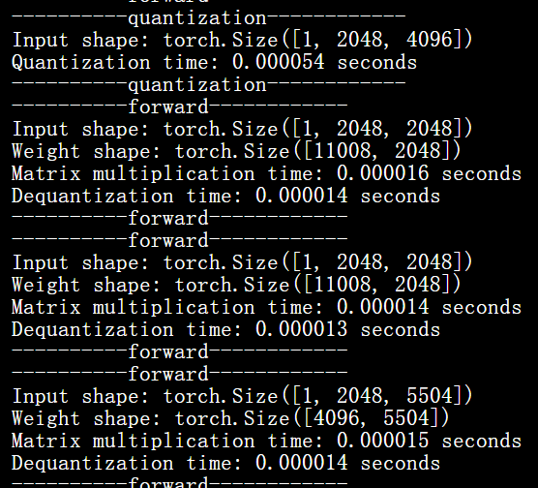
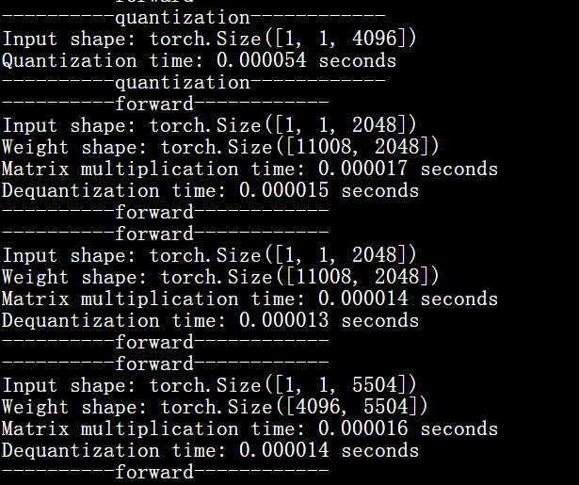
Quarot
激活量化占比 65.3%
vGPU-64GB
激活量化占比 64.5%

Slide 13
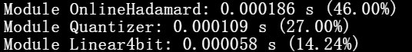
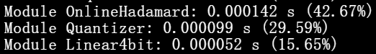
Quarot
down_proj
RXT 3090-24GB

Slide 14
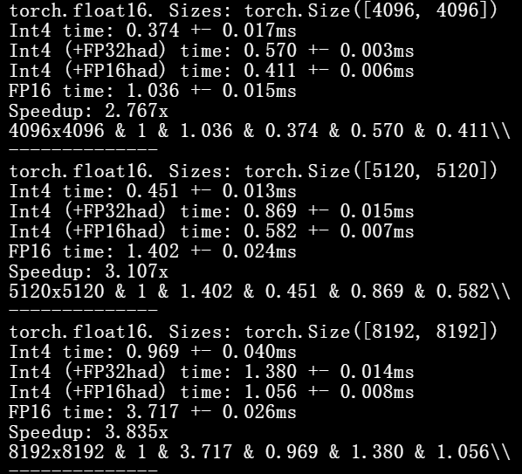
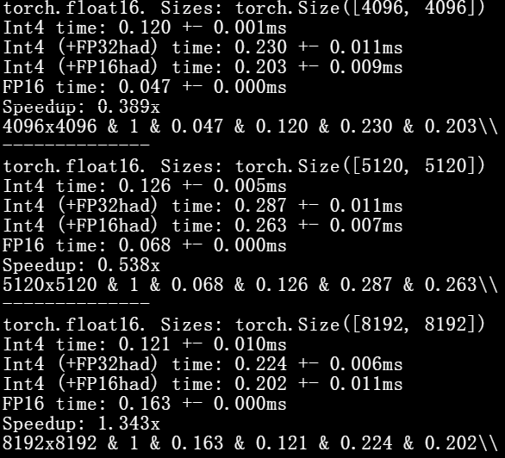
Quarot
RXT 3090-24GB

Slide 15
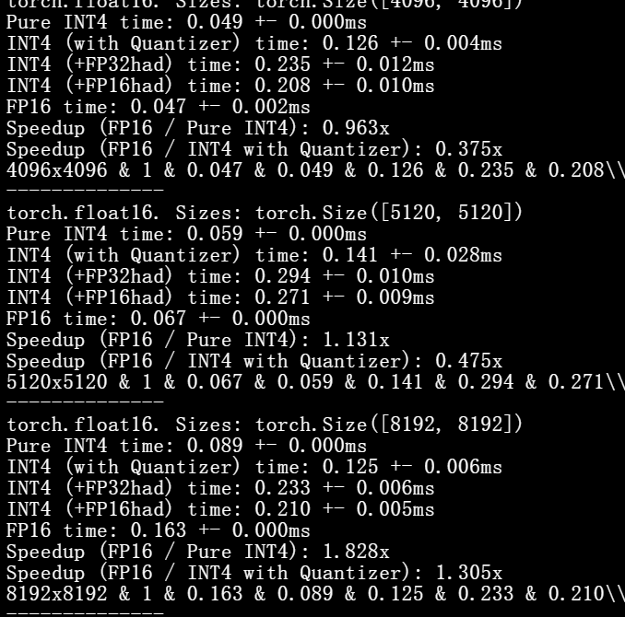
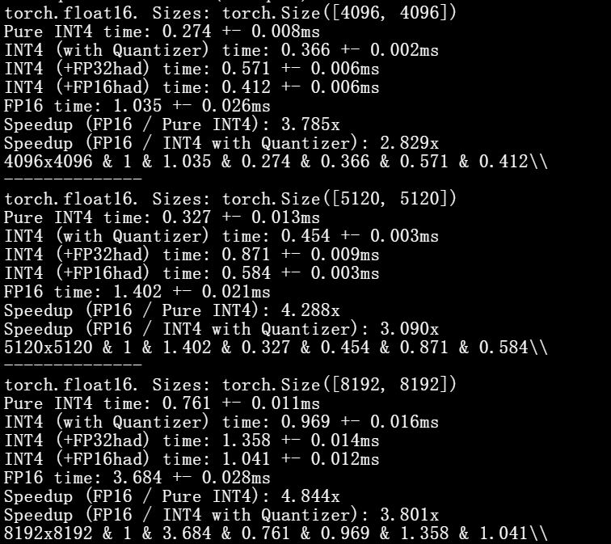
Quarot
RXT 3090-24GB

Slide 16
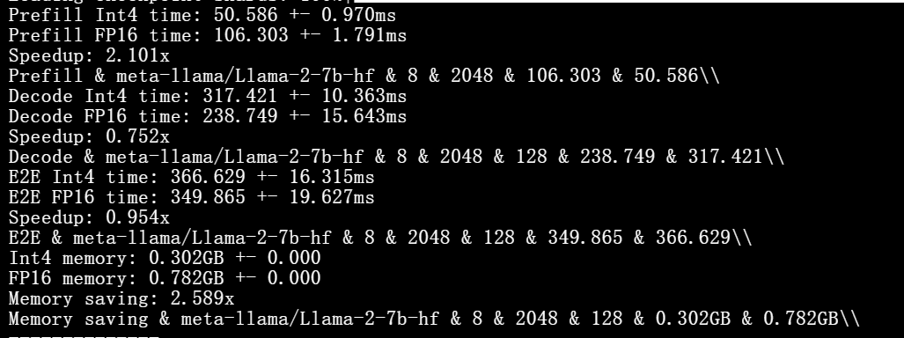
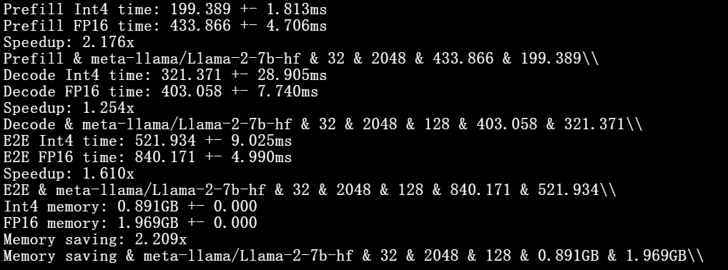
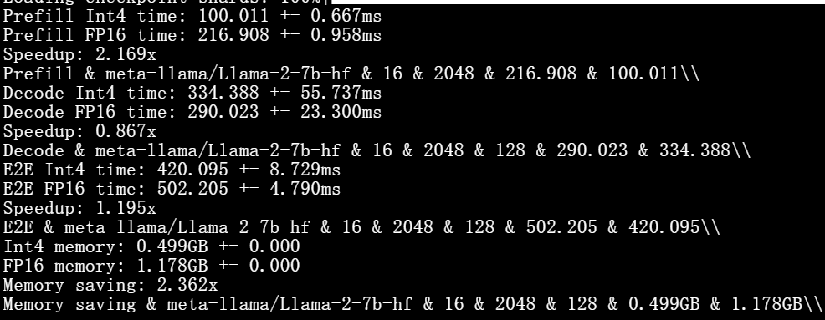
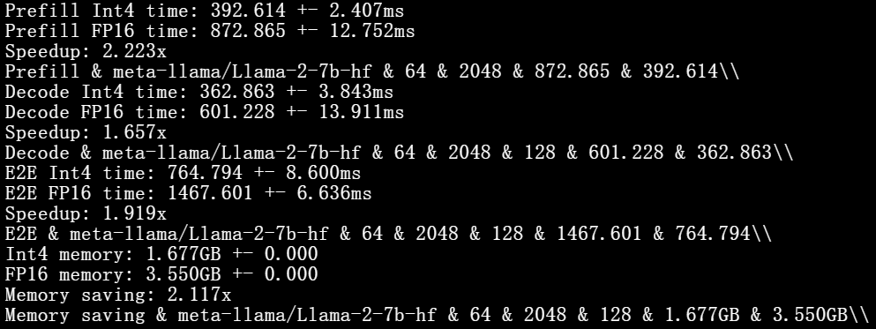
Quarot
batch_size = 8
batch_size = 32
batch_size = 1
batch_size = 16
batch_size = 64
batch_size = 4
RXT 3090-24GB

Slide 17
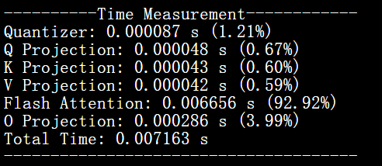
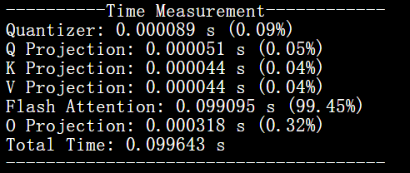
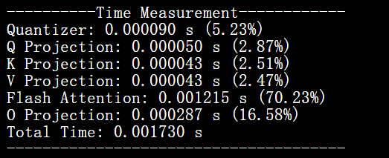
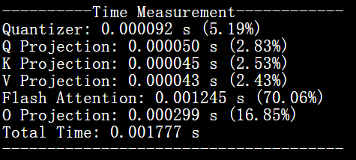
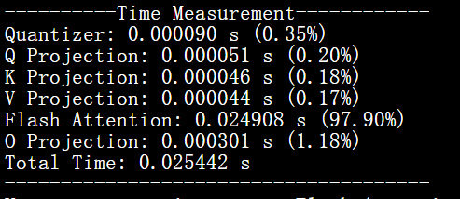
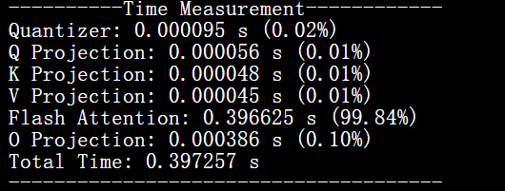
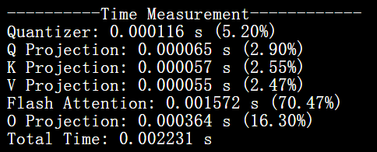
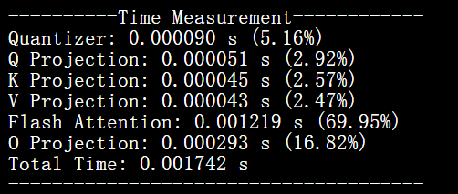
Quarot
seq_len = 2048,decode_steps=128
batch_size = 1
batch_size = 16
prefill
decode
batch_size = 4
batch_size = 64
RXT 3090-24GB

Slide 18
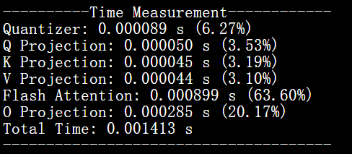
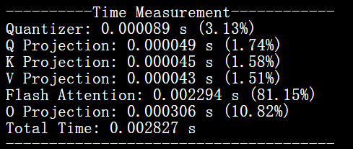
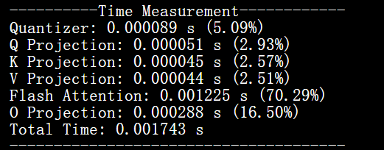
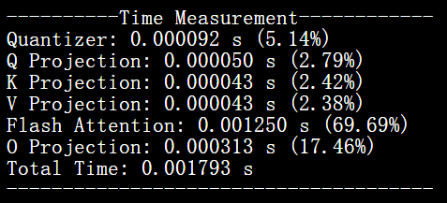
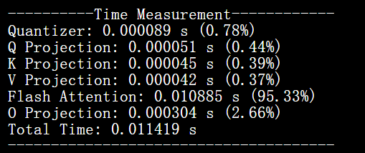
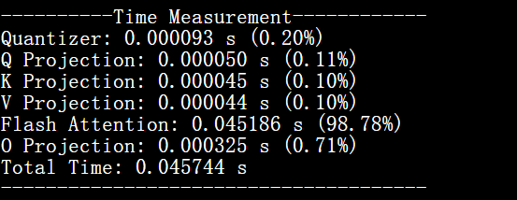
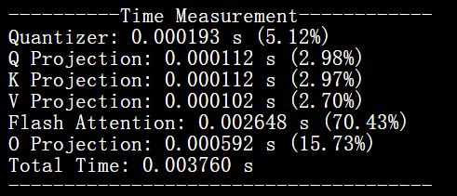
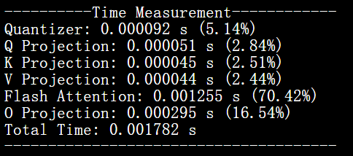
Quarot
seq_len = 256,decode_steps=128
batch_size = 1
batch_size = 16
prefill
decode
batch_size = 4
batch_size = 64
RXT 3090-24GB

Slide 19
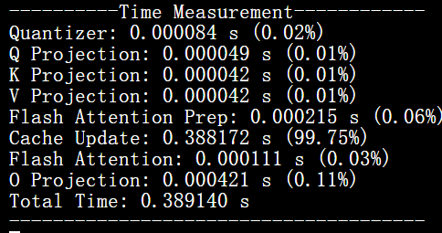



Quarot
seq_len = 2048,decode_steps=128,batch_size=64
fp16
int 4

Slide 20




Quarot

